Slide 1
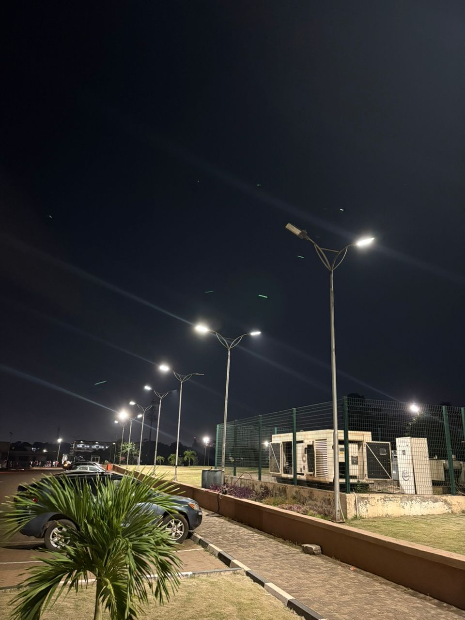
GROUP 11
AUTOMATIC STREET LIGHT SYSTEM
PRESENTED BY:
AZU SOLOMON BOATENG
URSULA AMIBASE AKELENZEA
ASANTE JUDITH
AMAMOO KOFI NYAMEDOW ADENTWI
BEATRICE ANTWI
JACOB MANTE ADUAMOYAW
ADDEY-BOTCHIE SENANU
MIKDAD MOHAMMED-KAMIL

Slide 2
TABLE OF CONTENTS
INTRODUCTION
PROBLEM STATEMENT
METHODOLOGY
APPROACH
CODE OVERVIEW
SCHEMATICS
DEMONSTRATION/SIMULATION
PROJECT RUN
OUTPUTS & KEY TAKEAWAYS
CONCLUSION
FINDINGS
CHALLENGES
IMPROVEMENTS

Slide 3
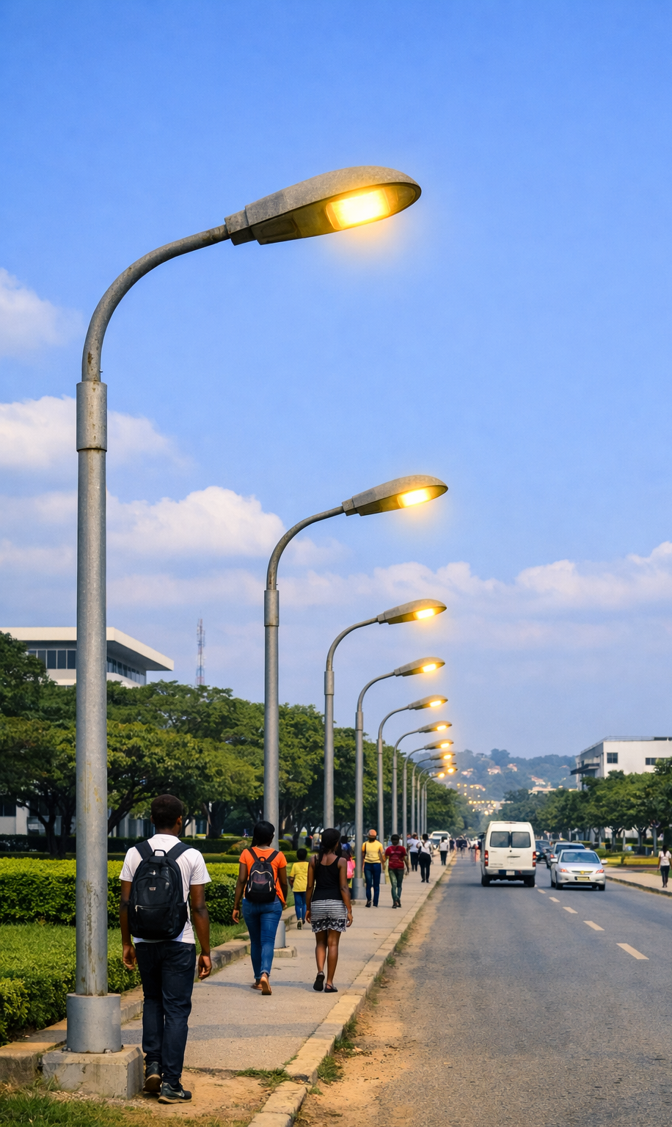
PROBLEM STATEMENT
Why are streetlights still on at noon?
Traditional streetlights are known for remaining switched on during daylight hours, leading to energy consumed unnecessarily
Relying on manual operation is very inefficient and prone to human error
This calls for the need of a smart solution that automatically controls streetlights based on ambient light levels
AIM:
To develop and simulate an automatic streetlight system that improves energy efficiency and reliability

Slide 4
METHODOLOGY
APPROACH
We used a Light Dependent Resistor (LDR) to detect ambient brightness. As light intensity increases, the LDR’s resistance decreases, producing a variable voltage across a voltage divider circuit.
This voltage is fed into the Arduino Uno’s Analog-to-Digital Converter (ADC), which converts the analog signal into a digital value between 0 and 1023. This value represents the light level.
SIGNAL PROCESSING
The Arduino compares the ADC value to a set threshold (say, 500).
If the value is below 500 → it’s dark → LEDs switch ON
If the value is above 500 → it’s bright → LEDs switch OFF
This logic ensures automatic control of streetlights based on real-time light conditions.

Slide 5
COMPONENTS: These are the main components we will need
NAME | QUANTITY | COMPONENT
U1 | 1 | Arduino Uno R3
R1 | 1 | Light Dependent Resistor (Photoresistor)
D4 | 1 | White LED
D3 | 1 | Yellow LED
R2 | 1 | 10 kΩ Resistor
R3,R7,R8 | 3 | 1 kΩ Resistor
R4,R5,R6 | 3 | 220 Ω Resistor
T2N2222,T1,T2 | 3 | NPN Transistor (BJT)
D1 | 1 | Red LED

Slide 6
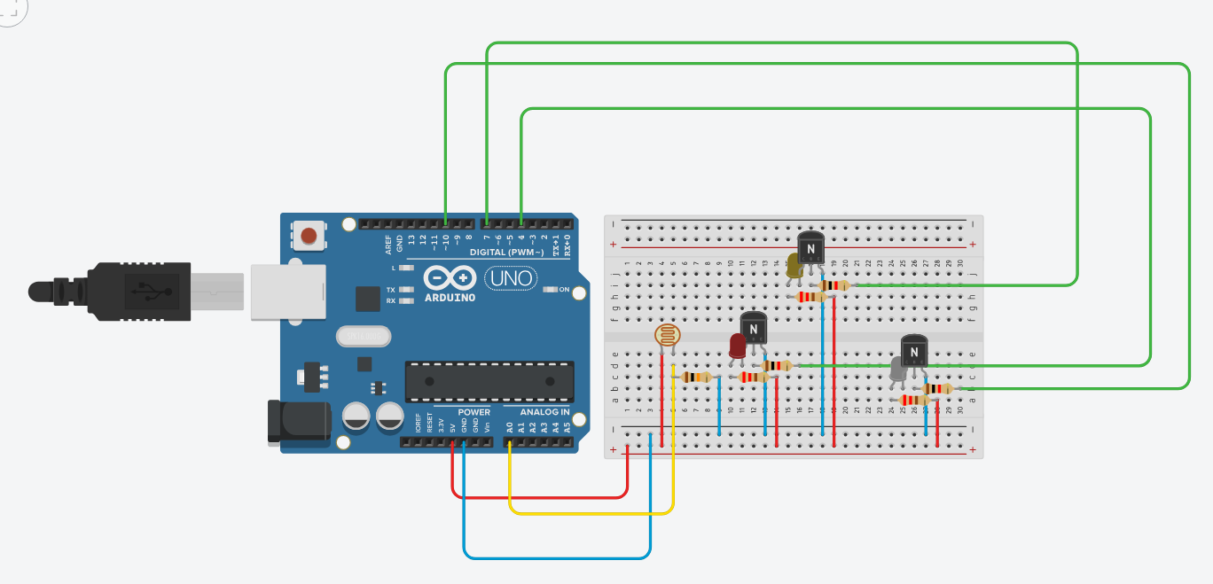
METHODOLOGY
CIRCUIT STABILITY
We used resistors to stabilize current and prevent erratic switching and transistor for the reliable switching.
Future upgrades may include exploring solar-powered options for energy efficiency.
SIMULATION & PROTOTYPE
The system was first tested in Tinkercad, where the LDR and LED behavior were simulated.
We then built a physical prototype on a breadboard using the same logic, confirming that the system responds accurately to ambient light levels.

Slide 7
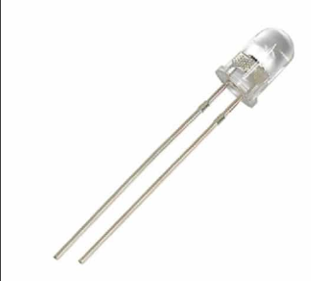

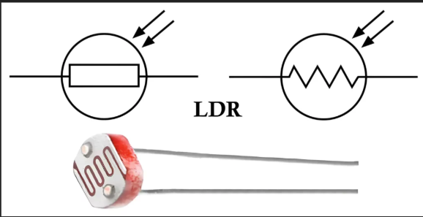
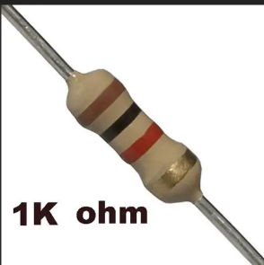
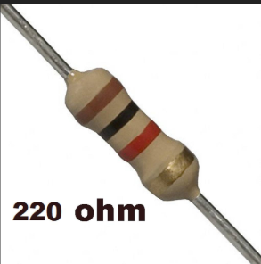
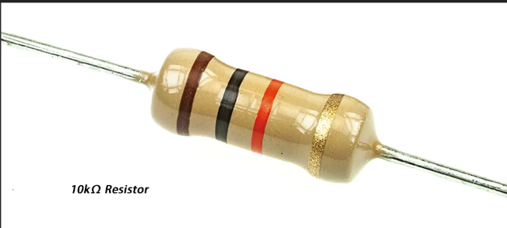
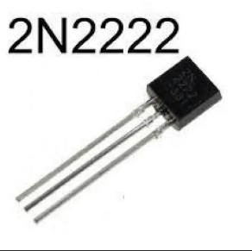

Slide 8
METHODOLOGY FUNCTIONS OF COMPONENTS
Arduino Uno R3 – Central microcontroller that reads sensor input and controls outputs
Light Dependent Resistor (Photoresistor) – Detects ambient light levels and changes resistance accordingly
White LEDs – Represent streetlights; turn ON/OFF based on light conditions
10 kΩ Resistor – Forms part of the voltage divider with the LDR for stable signal input
1 kΩ Resistor – Limits current to protect transistor base or LED
220 Ω Resistor – Protects LEDs by limiting current flow
NPN Transistor (BJT) – Acts as a switch to control LED power using Arduino signals

Slide 9
CODE OVERVIEW
Arduino reads values from the LDR (pin A0)
Compares sensor values with a threshold (500)
If dark → LEDs on pins 4, 7, 10 switch ON
If bright → LEDs switch OFF
Serial monitor prints sensor values for testing

Slide 10
SCHEMATICS
Circuit designed and simulated in Tinkercad
Arduino Uno controls LED switching based on light input
Transistors used to amplify control signals
Resistors stabilize current and protect components
LEDs represent streetlights in the system

Slide 11
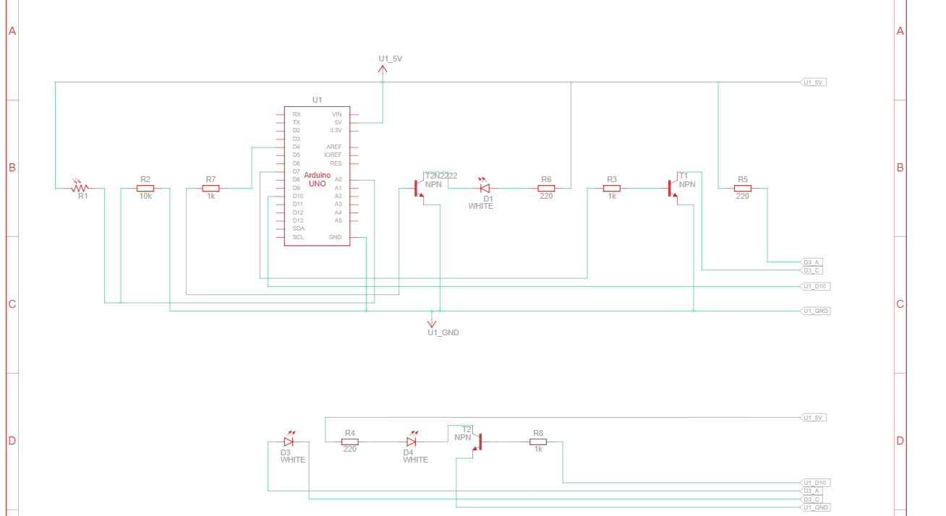
SCHEMATICS

Slide 12
DEMONSTRATION / SIMULATION
Testing Platforms:
Circuit simulated on Tinkercad.
Prototype built on breadboard.
Operation:
Dark → LEDs switch ON (streetlight effect).
Bright → LEDs switch OFF (daytime effect).
Results:
Lights respond automatically to sensor input.
Saves energy and reduces manual control.
Reliable performance in both simulation and prototype.

Slide 13
CONCLUSION
FINDINGS:
System switches LEDs ON at night and OFF during day automatically.
Saves energy and reduces manual effort.
CHALLENGES:
Sensor calibration for accurate detection.
Circuit stability during testing.
Difficulty in Transistor-LED connection on breadboard
Issues in voltage divider building
FUTURE IMPROVEMENTS
Integrate solar panels for sustainable power.
Expand to multiple streetlights.
Add motion sensors for smarter control.

